Slide 1
INSTALLATION
|AVR|

Slide 2
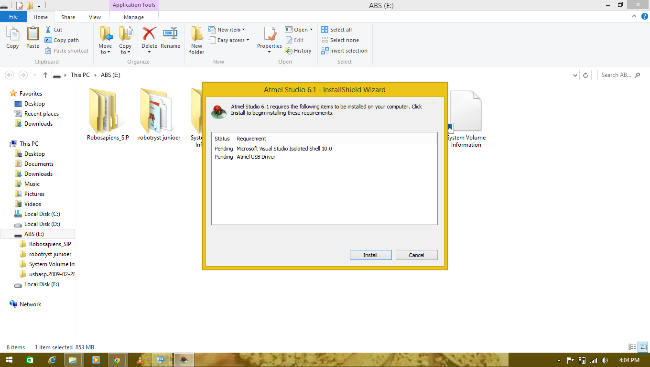
AVR
Click on next button

Slide 3
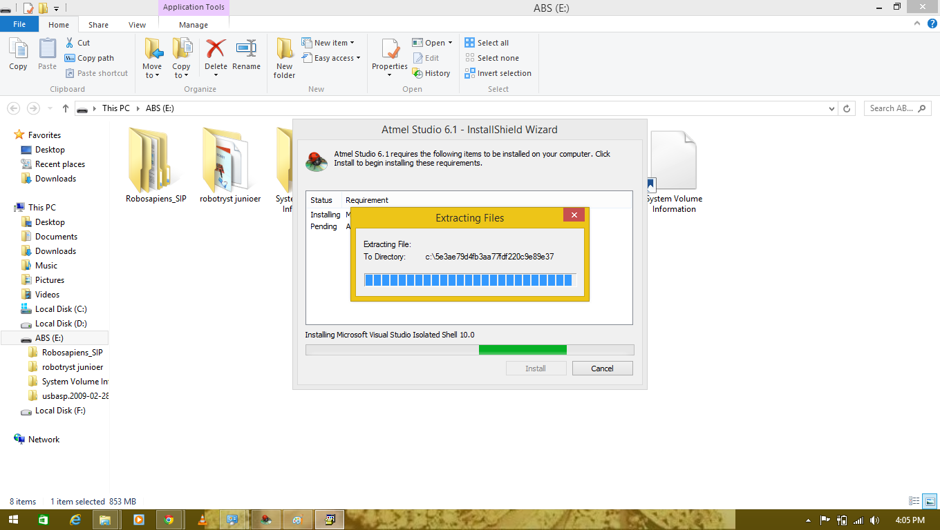
AVR
Extract the file

Slide 4
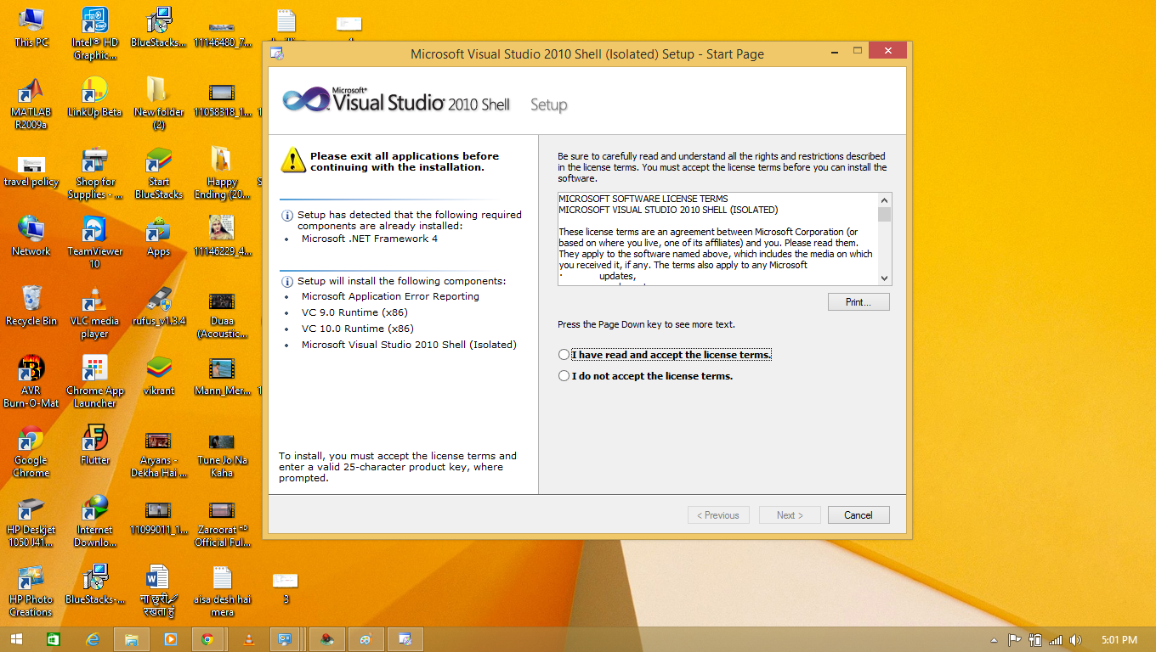
AVR
Click on next after clicking on the license terms

Slide 5
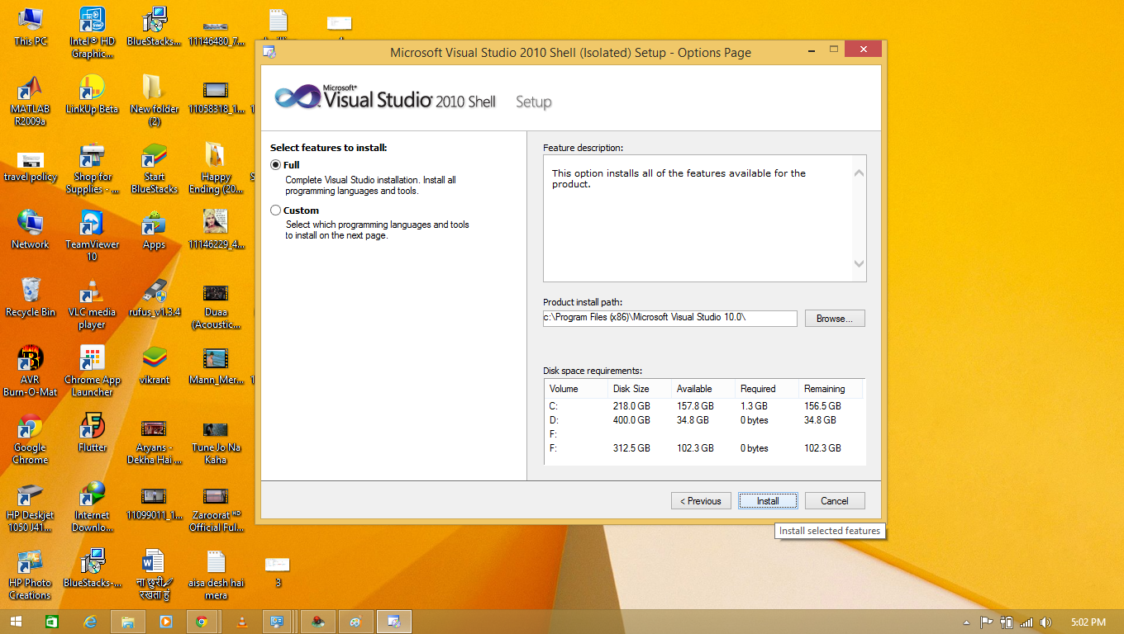
AVR
Select full and then click on install button

Slide 6
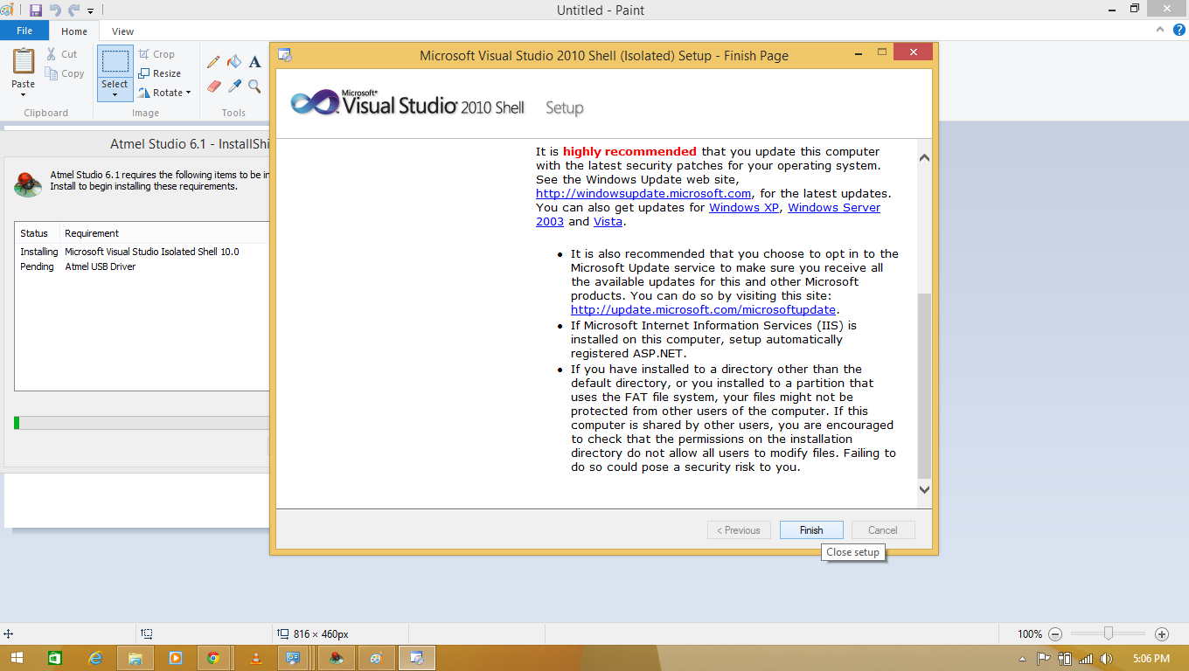
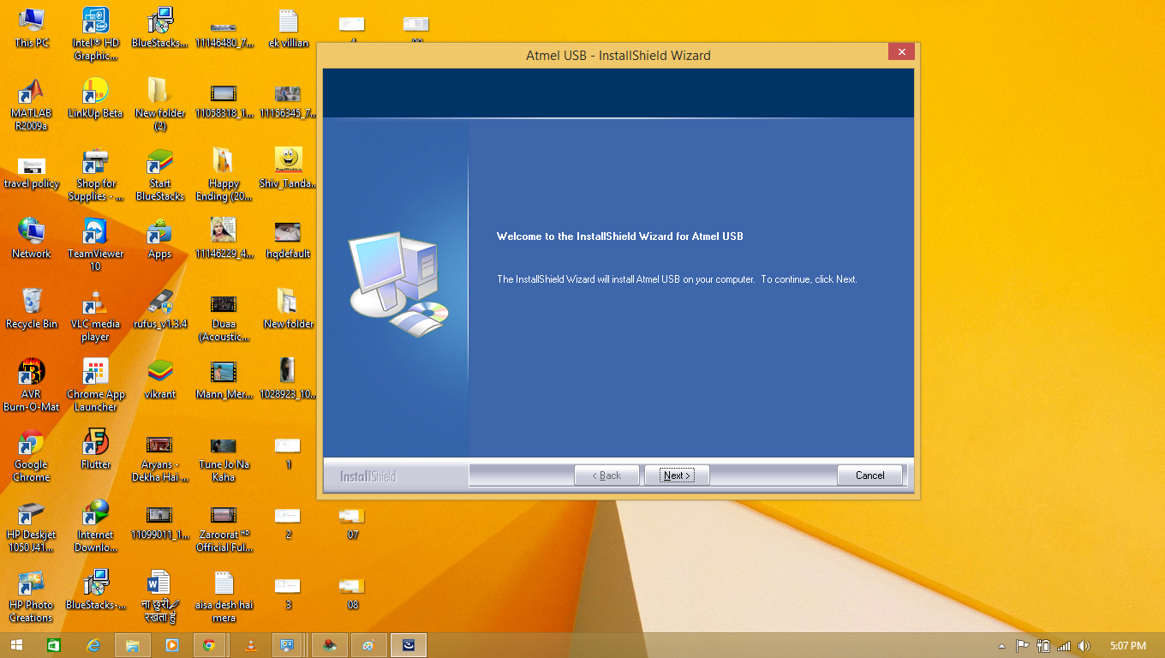
AVR
Click on finish button and then click on next button to install Atmel USB

Slide 7
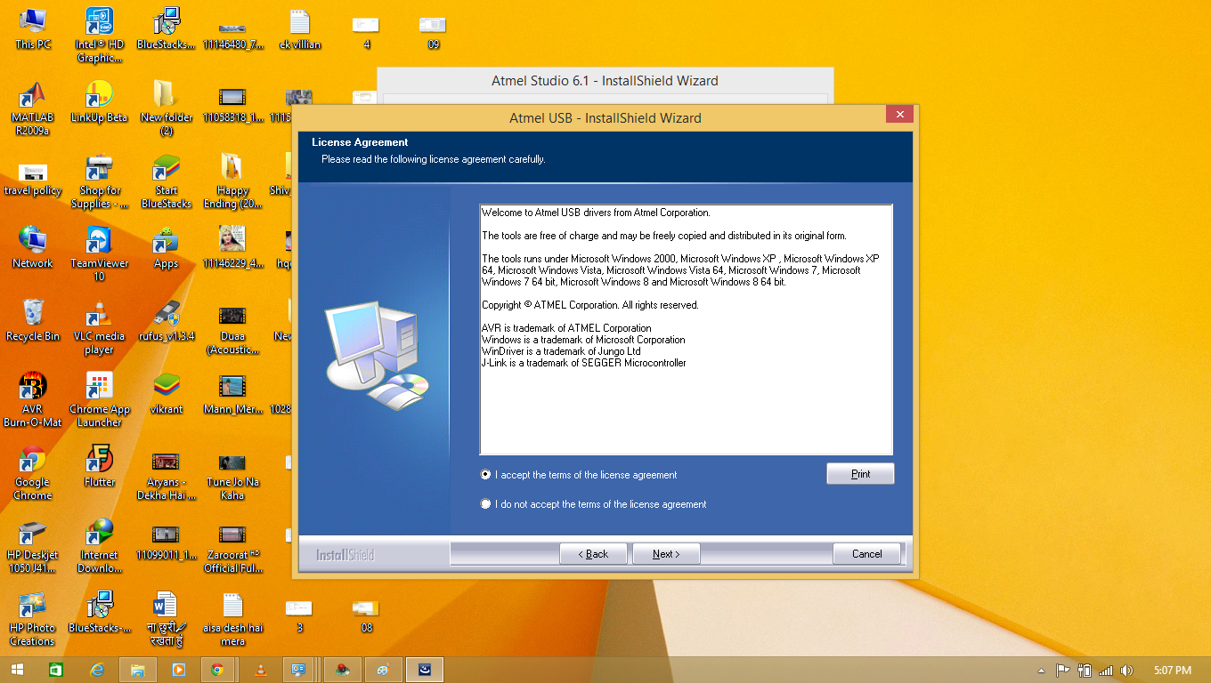
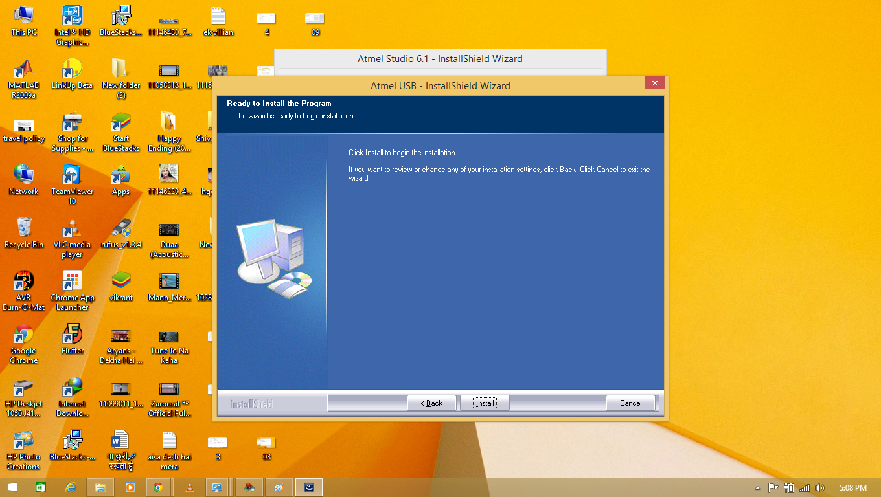
AVR
Click On License Then Next And Then Click On Install Button

Slide 8
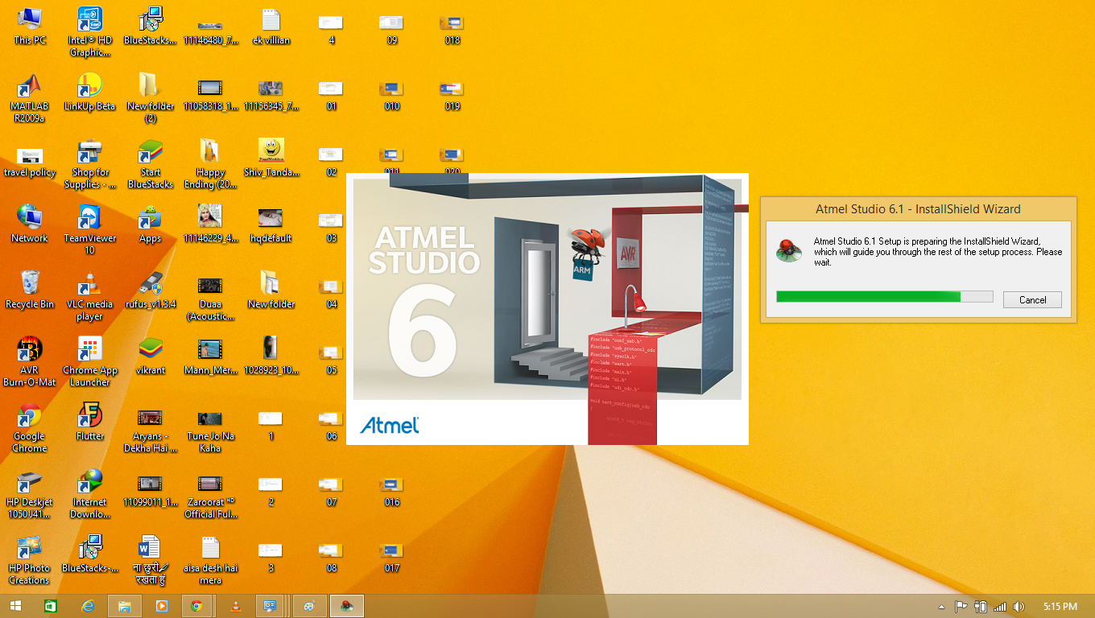
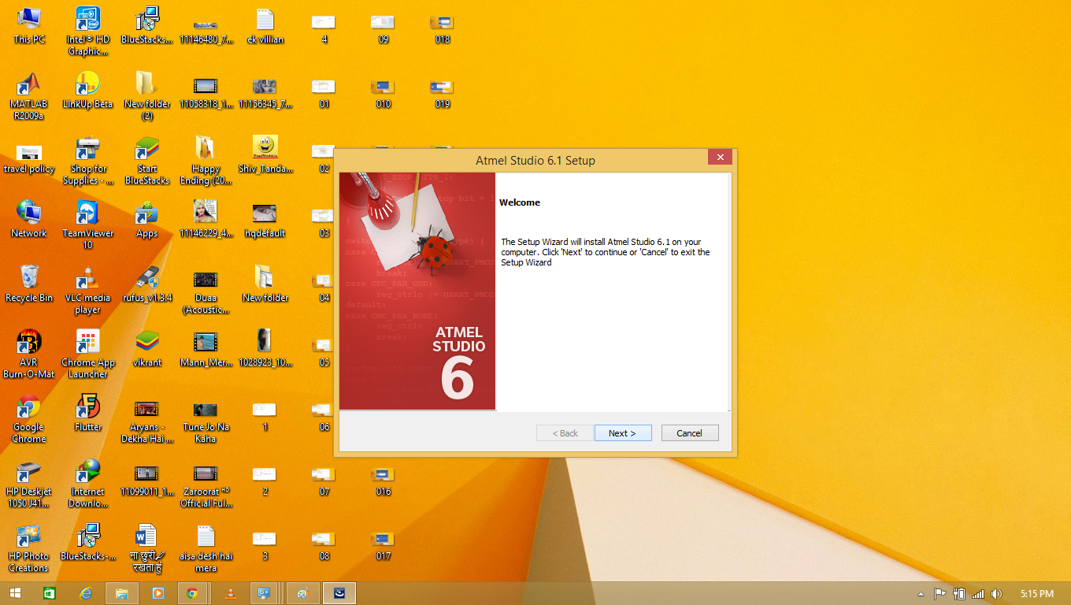
AVR
Click on next button

Slide 9
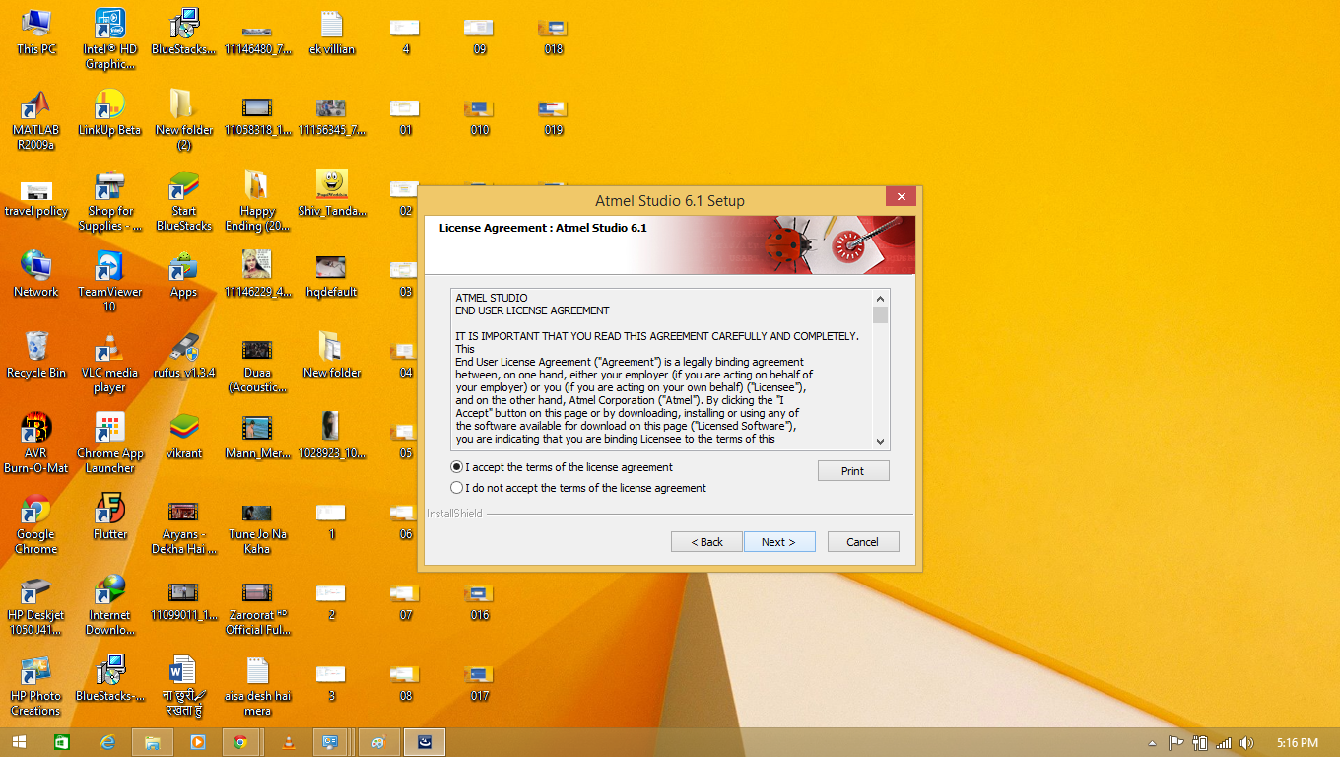
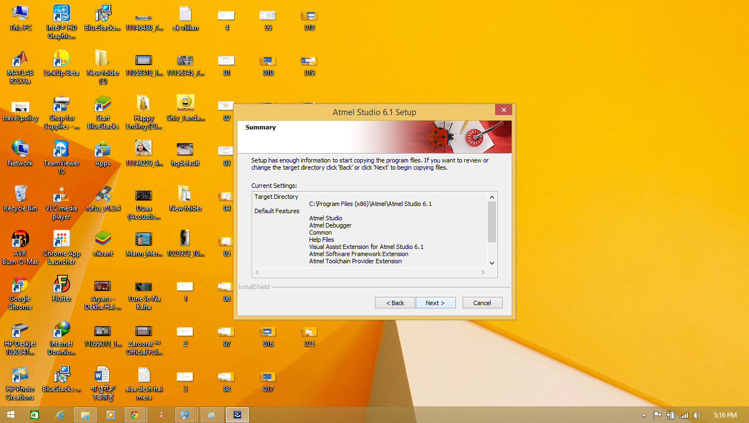
AVR
Click on accept button and then next

Slide 10
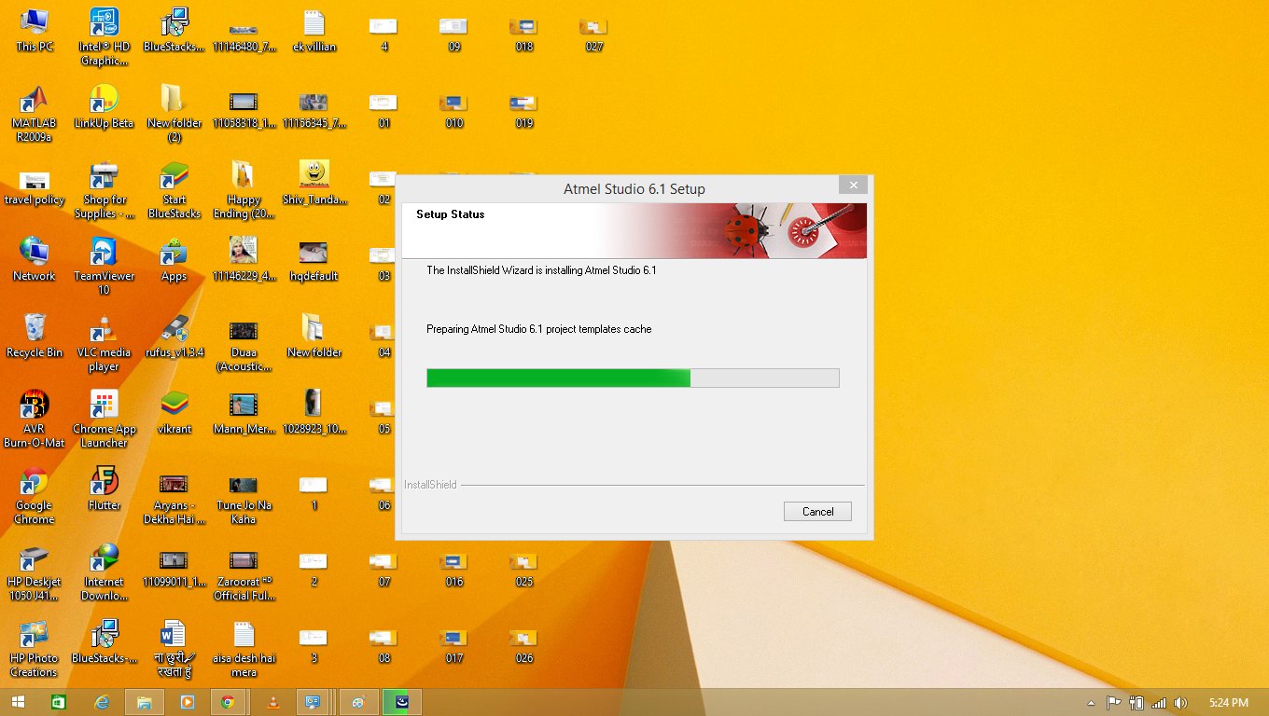
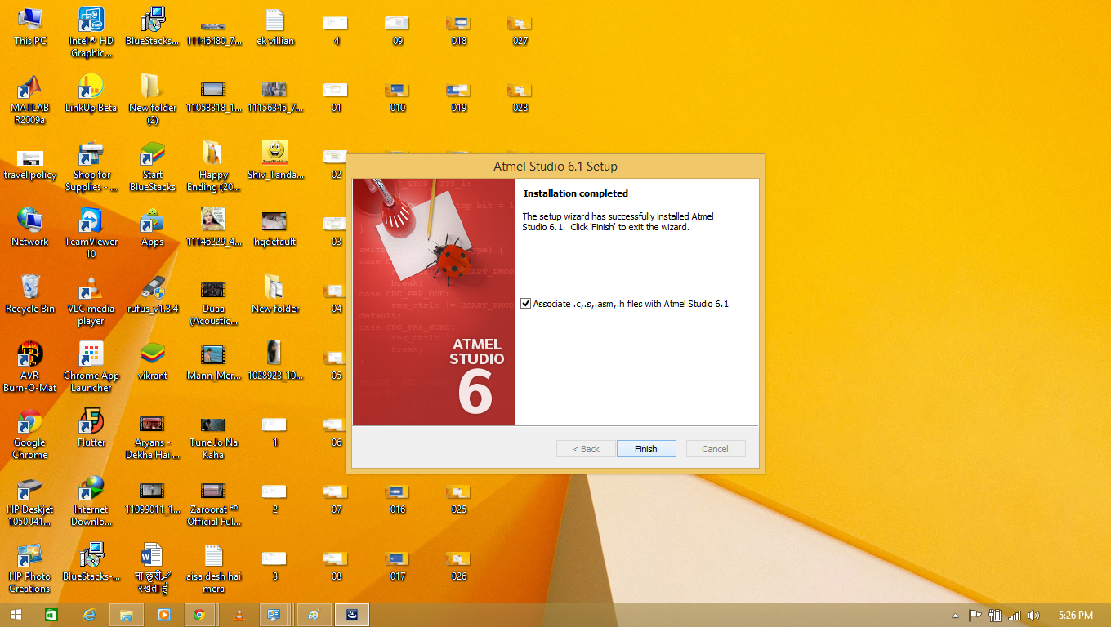
AVR
Click on Finish button

Slide 11
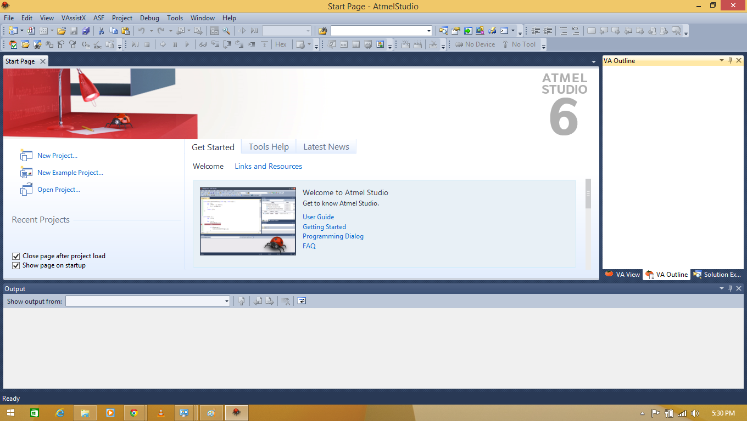
AVR
Click on Atmel Studio 6.1 Click on New Project

Slide 12
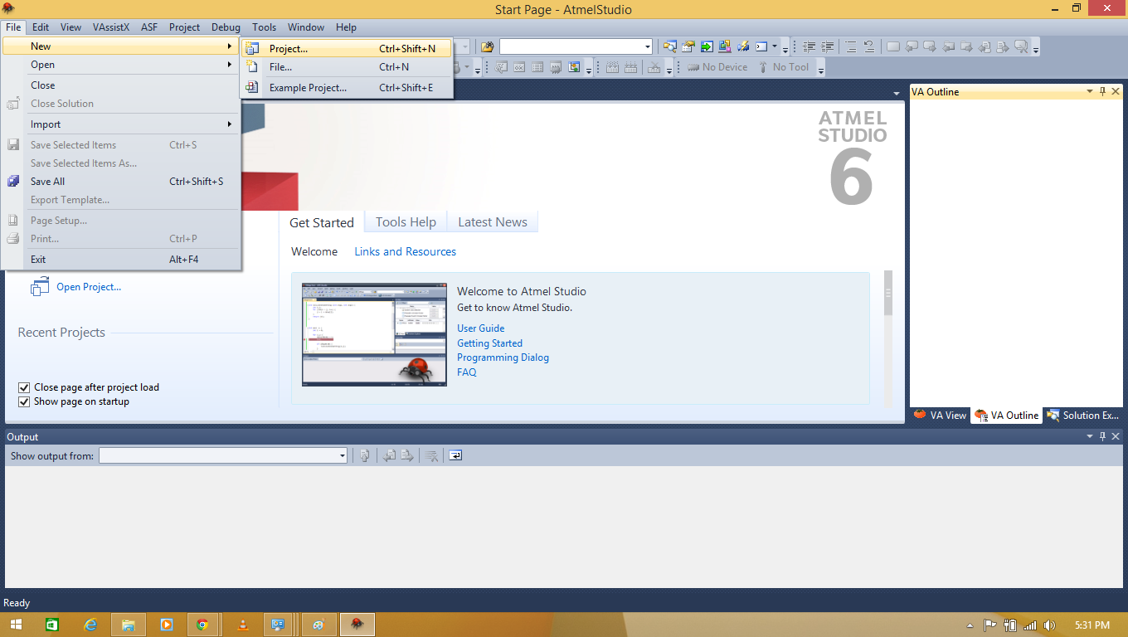
AVR
Click on file and then select new project

Slide 13
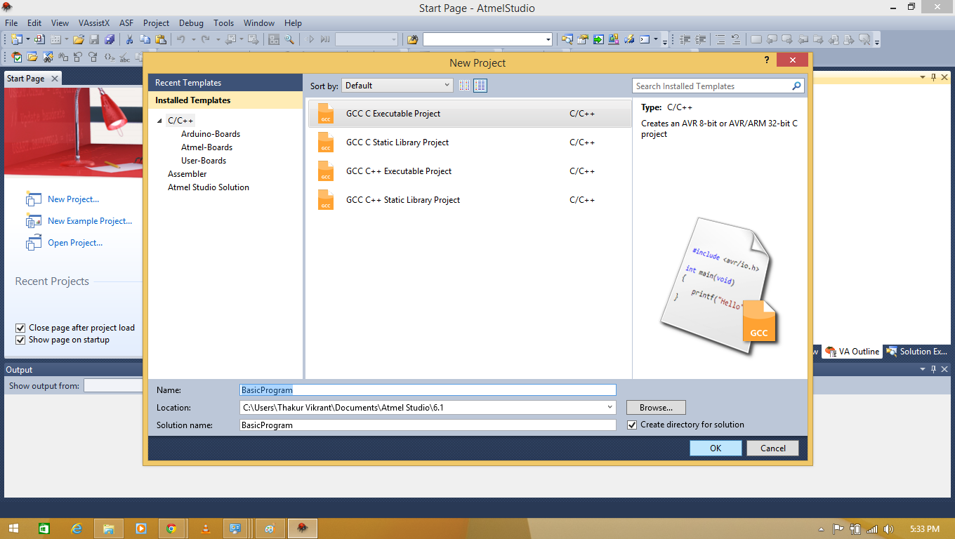
AVR

Slide 14
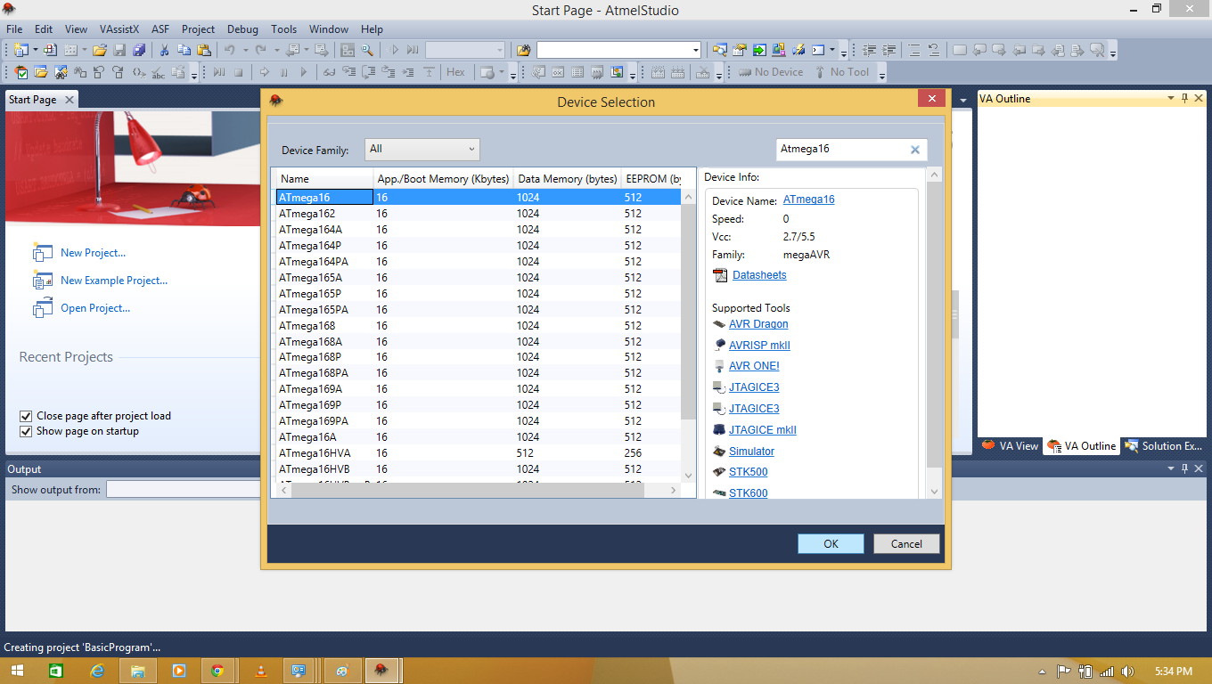
AVR

Slide 15
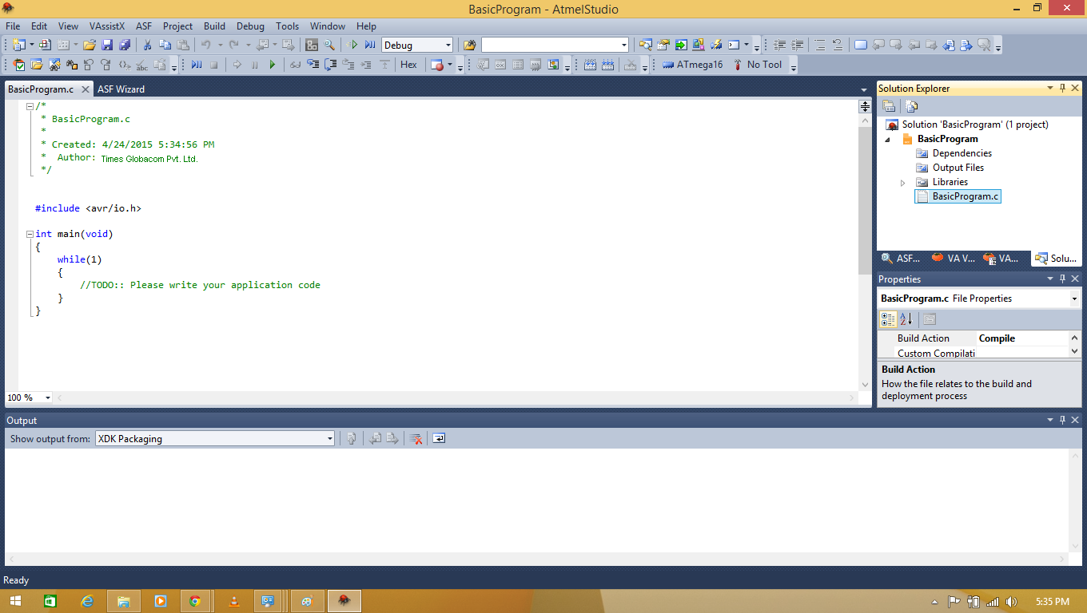
AVR

